Slide 1

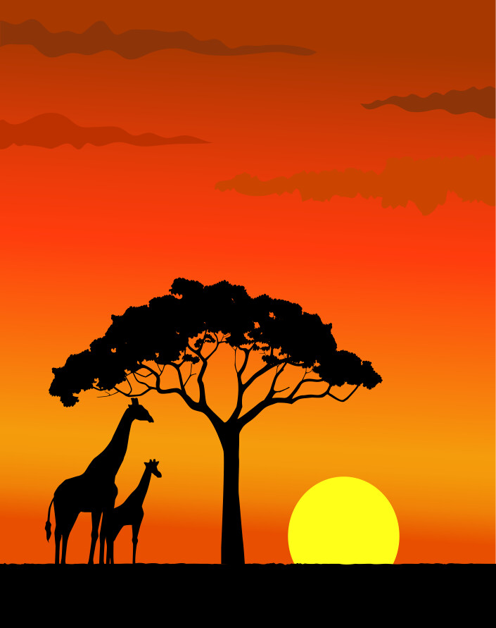
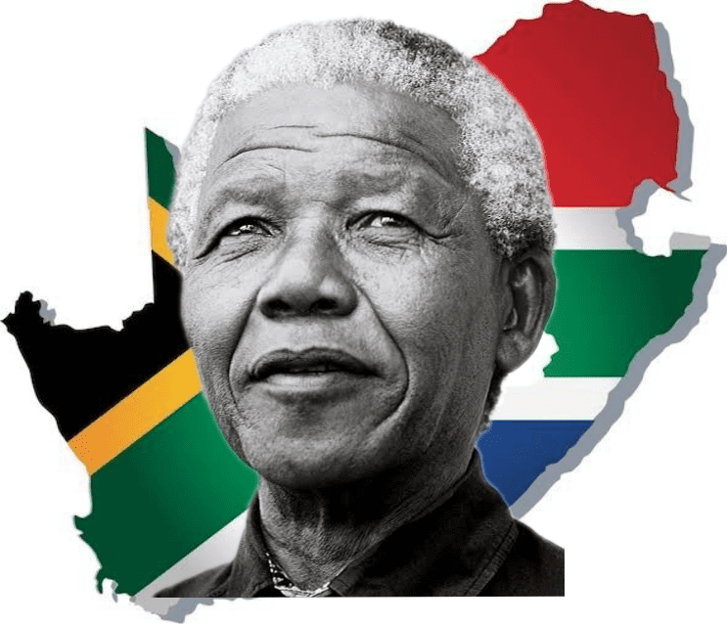
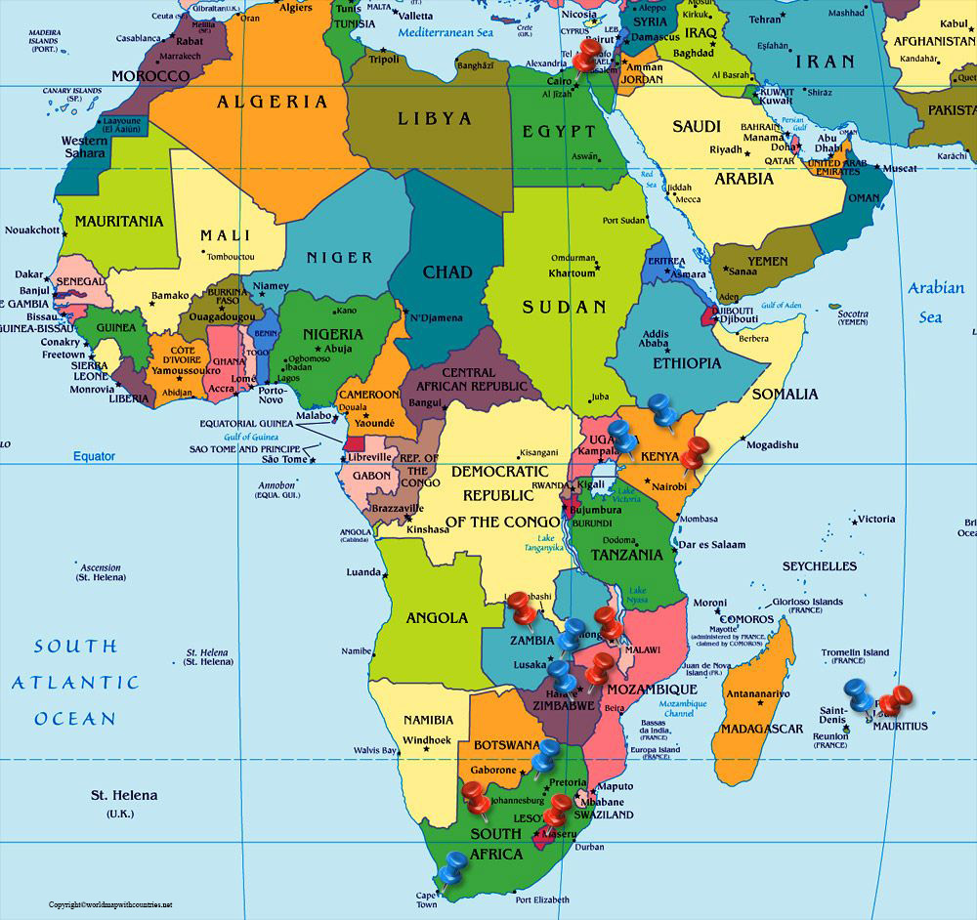
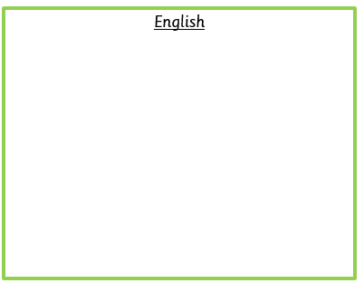

Year 4- Autumn Term
Africa
Science
Living things and their habitats
Describe how living things are classified and based on similarities and differences, including micro-organisms, plants and animals.
Give reasons for classifying plants and animals based on specific characteristics.
Teeth and eating
Describe the simple functions of the
basic parts of the digestive system in humans.
Identify the different types of teeth in humans and their
simple functions.
Construct and interpret a variety of food chains,
Name 5 food groups
Understanding what makes a healthy,
balanced meal.
Autumn 1:
The Loch Ness Monster
Orally recite facts about The Loch Ness Monster.
Innovate a story based on The Loch Ness Monster.
Newspaper article based on research of The Loch Ness Monster.
Autumn 2:
Crazy Creatures and Journey to Jo’burg.
Retell the story of Journey to Jo’Burg.
Create a digital fact file
based on a ‘Crazy Creature’.
Africa
History
How did Martin Luther King Jr. and Nelson Mandela help to change unfair rules for children in their countries?
Geography
Locate the world’s countries using maps to focus on Africa.
Compare different places by exploring the human and physical geography of regions in the United Kingdom, Europe, and North or South America.
Investigate the similarities and differences between communities and landscapes across different countries and continents.
Art
The children look at different African art and African landscapes. The outcome is to produce an African landscape in watercolour.
Maths
Our units of learning for this term are…
Number: Place Value
Number: Addition, Subtraction
Measurement: Area
Number: Multiplication and Division
Arithmetic paper every fortnight
Which values are considered important by people of faith?
World Faiths and World Views.
French
Name and recognise up to 10 vegetables in French. Attempt to spell some of these nouns. Learn simple vocabulary to facilitate a role play about buying vegetables from a market stall.
Computing
Computing Systems and Networks
PSHE
Health and Wellbeing
How can we keep healthy as we grow?
Looking after ourselves
Growing up
Becoming independent
Taking more responsibility
Music
Autumn 1: Create and Notate
Autumn 2: Singing and Traditions.
P.E
Autumn 1: Gymnastics
Autumn 2: Dance

